Slide 1
Recurrent Neural Networks (RNNs)
Deep Learning
Notes:
Introduction to the presentation on Recurrent Neural Networks (RNNs).

Slide 2
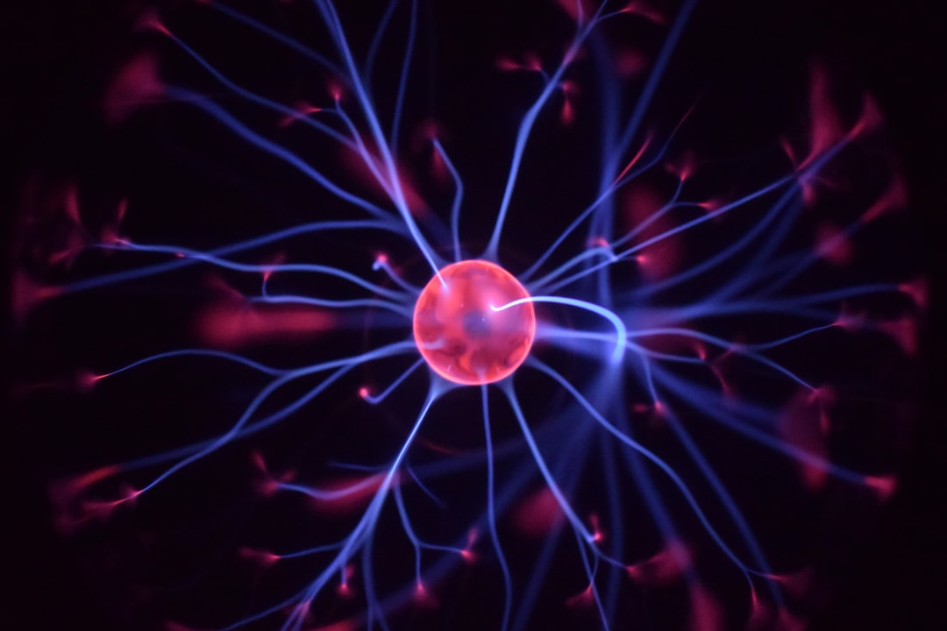
Introduction
Recurrent Neural Networks (RNNs) overview
RNNs for sequential data analysis
Time-series forecasting and natural language processing
Introduction to deep learning concepts
RNNs for speech recognition and machine translation
Basic RNN architecture and components
RNNs vs. traditional neural networks
Importance of RNNs in AI and machine learning
Real-world applications of RNNs
RNNs in computer vision and signal processing
Notes:
Introduce the concept of Recurrent Neural Networks (RNNs) and their importance in deep learning. Explain how RNNs are used for sequential data analysis and provide examples of real-world applications. Ask students if they have any experience with RNNs or deep learning.

Slide 3
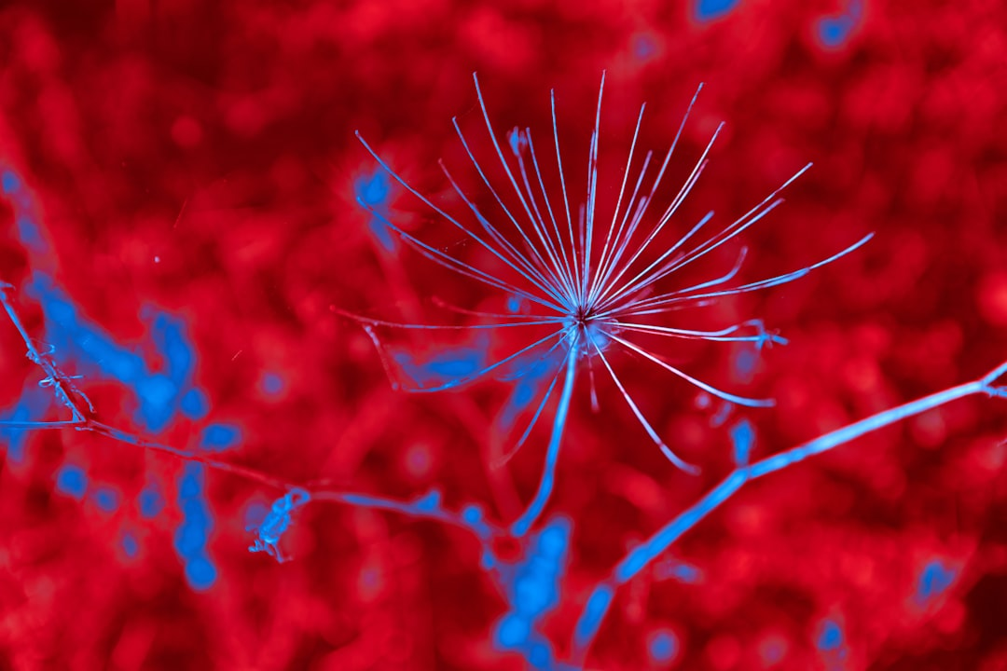
Architecture
Basic RNN architecture components
Input gate, output gate, and forget gate
Recurrent connections and feedback loops
Cell state and hidden state
Activation functions and nonlinearities
RNN layers and stacking
Bidirectional RNNs and encoder-decoder models
Gated Recurrent Units (GRUs) and Long Short-Term Memory (LSTMs)
Comparison of different RNN architectures
Notes:
Explain the basic architecture of RNNs, including the input gate, output gate, and forget gate. Describe the role of recurrent connections and feedback loops. Provide examples of different RNN architectures, such as GRUs and LSTMs, and ask students to compare and contrast them.

Slide 4
Mathematical Formulation
RNN mathematical formulation overview
Recurrent neural network equations
Activation functions and derivatives
Backpropagation through time (BPTT) algorithm
Computing gradients and updating weights
Vanishing and exploding gradient problems
Gradient clipping and normalization techniques
Mathematical notation and conventions
Derivation of RNN equations and BPTT algorithm
Notes:
Derive the mathematical formulation of RNNs, including the recurrent neural network equations and activation functions. Explain the backpropagation through time (BPTT) algorithm and provide examples of computing gradients and updating weights. Ask students to work through the derivation of the RNN equations and BPTT algorithm.

Slide 5
Training and Backpropagation Through Time
RNN training overview and objectives
Loss functions and optimization algorithms
Backpropagation through time (BPTT) algorithm
Truncated BPTT and approximate methods
Gradient descent and stochastic gradient descent
Mini-batching and batch normalization
Regularization techniques and dropout
Early stopping and learning rate scheduling
RNN training best practices and tips
Notes:
Explain the training process for RNNs, including the objectives and loss functions. Describe the backpropagation through time (BPTT) algorithm and provide examples of truncated BPTT and approximate methods. Discuss the importance of regularization techniques, such as dropout, and ask students to work through an example of training an RNN.

Slide 6
Applications
Natural language processing and text analysis
Speech recognition and machine translation
Time-series forecasting and prediction
Computer vision and image processing
Recommendation systems and collaborative filtering
Sentiment analysis and opinion mining
Question answering and chatbots
Speech synthesis and voice recognition
Real-world applications and case studies
Notes:
Provide examples of real-world applications of RNNs, including natural language processing, speech recognition, and time-series forecasting. Ask students to think of potential applications of RNNs in their own fields of interest. Discuss the importance of RNNs in AI and machine learning and provide case studies of successful RNN deployments.

Slide 7
Advantages and Limitations
RNN advantages: handling sequential data
RNN limitations: vanishing and exploding gradients
RNN advantages: flexible and adaptable
RNN limitations: computational complexity
RNN advantages: state-of-the-art performance
RNN limitations: require large amounts of data
RNN advantages: can be used for both supervised and unsupervised learning
RNN limitations: can be difficult to interpret and visualize
Comparison of RNNs with other deep learning models
Notes:
Discuss the advantages and limitations of RNNs, including their ability to handle sequential data and their susceptibility to vanishing and exploding gradients. Ask students to weigh the pros and cons of using RNNs in different applications. Provide examples of how RNNs can be used in combination with other deep learning models to overcome their limitations.

